Slide 1
Object Oriented programming

Slide 2



Contents
Objectives
To understand types and how to create objects
To grasp the concept of reference type behaviour
Contents
OO fundamentals – abstraction and encapsulation
Defining reference types
Creating objects (instances)
Hands-on labs

Slide 3




OO fundamentals – Abstraction
Ability to represent a complex problem in simple terms
  Creation of a high-level definition to simplify complexity
  Exposing only the relevant features. Hiding the complex implementation
Stresses ideas, qualities, and properties – not particulars
  Emphasises what an object is or does, rather than how it works
Interface
Many drivers are unaware of car mechanics but can still drive a car.

Slide 4
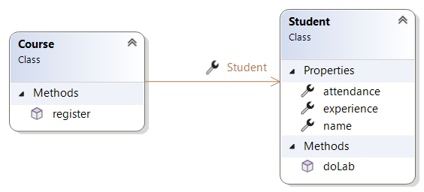
An example of using abstraction
Students (instances of type Student) attending a Course
      Have ‘attributes’- name, experience, attendance record
      Have ‘behaviour’ - register(), doLab()
      Are part of ‘relationships’
      A student attends a course
      A course ‘has’ many students
      A Student can register on a course
      but doesn’t need to know how it's done
*
public void register(Student student) {
// code
UML diagram

Slide 5

OO fundamentals – Encapsulation
Hiding object’s implementation, making it self-sufficient
Process of enclosing code needed to do one thing well
  Store necessary data in one object
  Build complexity from simple objects
  Hide internal details (e.g., lab performance)
  Users just need to know the inputs and outputs
  Improve reliability, maintainability, and reuse
*
*

Slide 6
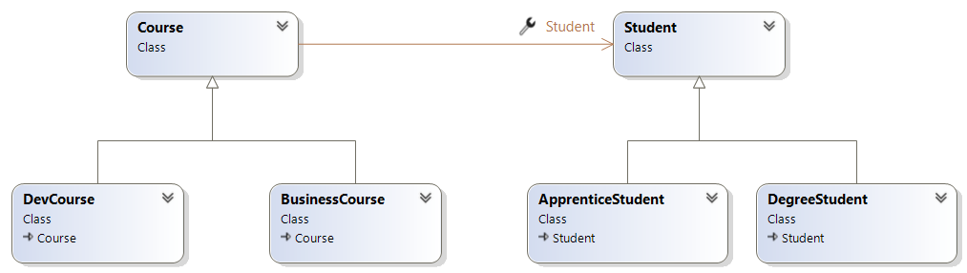
Inheritance
Is an OOP concept where a subclass inherits properties and behaviour from a superclass.
It promotes code reuse and enables polymorphism.
*

Slide 7


OO fundamentals – Objects communicate
Objects communicate via messaging (method calls).
  Messages allow (receiving) object to determine implementation.
  for(Student stu : students){
  stu.doLab(2);
  }
*
Do lab 2
*

Slide 8
What is an OO data type?
Class definition is a blueprint for making objects
Fields - Constituent data parts, hold state
Methods - Methods that define behaviour
public class Car {
public String make;
public int speed;
public void start() {
speed = 1;
}
public void accelerate(int amount) {
speed += amount;
}
}
Fields
State
Public members are
an object's interface
Methods
Behaviour
Notes:
Types define the content and the behaviour of objects. It is a blueprint which the runtime will use to determine what memory needs to be allocated at run-time, and which the compiler will use to validate that your code is correct.
Types consist of two sorts of members: fields and methods.
Fields define the data elements from which your types are composed. For example, every car has a make and a model; these would therefore make ideal fields in a program that let's users browse car information on the web.
Methods are the functions (or operations) that determine the behaviour of instances of the type, or of the type itself. Looking at our car example again, methods might include starting the car, steering it, accelerating (and braking!), and parking.

Slide 9
Creating objects
Objects are unique instances of a class with their own state.
public static void Main(…) {
Car car1 = new Car();
Car car2 = new Car();
car1.make = "Ford";
car2.make = "BMW";
car1.accelerate(10);
car2.accelerate(15);
}
Blueprint
public class Car {
public String make;
public int speed;
public void start() {
speed = 1;
}
public void accelerate(int amount) {
speed += amount;
}
}
make: "Ford"
speed: 10
Instances of Car
make: "BMW"
speed: 15
Notes:
Remember, the type definition is simply a blueprint of methods and fields. Objects, on the other hand, are instances of the type. They have their own state (the values in the fields) and their own identity, which in the world of a computer program is the address in memory that the object is stored in.

Slide 10

Getters and setters – Property procedures
Do not expose state
My bank account number is private!
What is your bank account number?
Notes:
Private fields should not be exposed as public. You would not expect someone outside of your car to change your speed or make of your car!
In the above example, name and age are made private to protect them, but how would you set these states?

Slide 11
Getters and setters
Do not expose state
public class Student {
private String name;
private int age;
}
public static void Main(…) {
Student stu = new Student();
stu.name = "Bob"; ✗
stu.age = 25; ✗
}
Notes:
Private fields should not be exposed as public. You would not expect someone outside of your car to change your speed or make of your car!
In the above example, name and age are made private to protect them, but how would you set these states?

Slide 12
Exposing state through Property methods
public class Student {
  private int age;
  private string name;
  public string Name
  {
    get { return name; }
    set { name = value; }
  }
  public int Age
  {
    get { return age; }
    set {
    if( value > 0)
    age = value;
    }
  }
}
public static void Main(…) {
Student stu = new Student();
stu.name = "Bob"; ✗
stu.age = 25; ✗
stu.Name = "Bob"; ✓
stu.Age = 25; ✓
}
Name and age are private
But name is not changed
Notes:
In the above example, name and age are made private and the only way to change them is through the get and set methods. You can build safety in these methods. For example, names must be greater than one character or age must be a positive number and within a range.

Slide 13
Exposing state through Auto implemented Properties
public class Student {
public int Age { get; set; }
public string Name { get; private set; }
public void Register() {
Name = "Bob"; ✓
}
}
public static void Main(…) {
Student stu = new Student();
int name = stu.Name; ✓
stu.Name = "Bob"; ✗
stu.Age = 25; ✓
int age = stu.Age; ✓
}
Parts of .NET libraries do not consider state unless exposed using getters and setters
Notes:
In the above example, name and age are made private and the only way to change them is through the get and set methods. You can build safety in these methods. For example, names must be greater than one character or age must be a positive number and within a range.

Slide 14

Object Construction
Let's consider two classes and the two instances created
public class Account {
private int id;
private String owner;
}
public class Car {
private int speed;
private String make;
}
Car myCar = new Car();
Account myAccount = new Account();
What make is this?
What is its speed?
What is the id of this account?
Who owns it?
We need a constructor
Notes:
In the above example the model and speed of the car will be null and zero by default. The account id and owner will be zero and null.
Obviously we can ask developers to set these after the instance is created but there are two problems with this approach. There is no guarantee a future develop would do this. We really don't want an account with id of zero in our system! And the other problem is, how do you set a private field with no setter?
We need a constructor to set these initial values and to hide the default parameter-less constructor. Parameter-less constructors are the ones used to creat an instance of Account and Car on the slide.

Slide 15
Constructor
public class Account {
private int id;
private String owner;
public Account (int id, string owner) {
this.id = id;
this.owner = owner;
}
}
The same name as the class.
No return value. Not even void
Account myAccount = new Account(123, "Bob"); ✔️
Account myAccount = new Account(); ❌
No default constructor.
must provide the owner's ID and the name

Slide 16
Object Construction - Overloading
Overloading provides alternative ways for creating an instance
public class Account {
private int id;
String owner;
public Account (int id, String owner) {
this.id = id;
this.owner = owner;
}
public Account (int id) {
this.id = id;
this.owner = getOwnerById(id);
}
}
Account myAccount = new Account(123, "Bob");
Account myAccount = new Account(123);

Slide 17
Constructor Chaining Example
public class Car {
private String make;
private int numdoors;
public Car(String make, int nd ) {
this.make = make;
this.numdoors = nd;
// common code can sit here
}
public Car(String make) : this(make, 4) {
}
}
1
Car car1 = new Car("BMW",5);
Car car2 = new Car("BMW");
Car car3 = new Car();
✗
2
Chaining, using special syntax
Notes:
In the type definition above you can see that two (overloaded) constructors have been defined (1) and (2). These constructors can be invoked using the new operator, with the arguments being provided within the parentheses, as shown above.
Note that you can also explicitly initialise fields at their point of declaration (1). You should be aware that the field initialisations occur before the constructor is invoked for the object.
Finally, you should note the constructor chaining syntax (2). This instructs the compiler to call the constructor which takes a String and an int as parameters, in this case, before executing the body of the constructor from which it is being called.
It is possible to chain multiple constructors together in this way.

Slide 18
The null Reference
public Car getPoolCar() {
Car aCar = null;
// attempt to get a Car
from a pool of cars
return aCar;
}
aCar may not reference an object
public void hireCar() {
Car myCar = getPoolCar();
if (myCar != null) {
// Drive the car away
} else {
// No car available
}
}
Can compare an object reference with null

Slide 19
What is a struct ?
A struct is mainly used to package small number of other Value types together
Can be instantiated without using the new keyword.
Can declare constructors with parameters but the default one will always remain!
Can have fields, properties and methods just like classes
Cannot inherit from another struct or class (no OO!)
Notes:
Struct is another type offered by Microsoft. Its code look like a class but it behaves like a value type. Therefore it can v=be passed by value (by copy) to a method).
It must be said that structs ae rarely used by developers but it is frequently used by the .Net framework to create types such as int, double…Point, Rectangle and so on.
A value type lives on the stack and is therefore not subject to garbage collection.
Structs are meant to be pure value types so please do not embed reference types such as a sring object inside a struct. The compiler does not mind but you should.
Structs are passed by copy so do not create a struct that takes too much space. The typical rule is 16 bytes of length but this is just a performance rule.

Slide 20
What is a struct ?
Microsoft has defined many structs such as int and double which you've used already!
  It has many more, like Rectangle, Point, Size,…
  struct types can be passed by Value (by copy) from one method to another
structs live on the Stack not the Heap and are more efficient than reference types, but…
  Do not define fields that are reference types (like string, array, List, or any other object)
  Keep the overall size of the fields small
There aren't many instances in real life to create a struct but they do show up!
Notes:
Struct is another type offered by Microsoft. Its code look like a class but it behaves like a value type. Therefore it can v=be passed by value (by copy) to a method).
It must be said that structs ae rarely used by developers but it is frequently used by the .Net framework to create types such as int, double…Point, Rectangle and so on.
A value type lives on the stack and is therefore not subject to garbage collection.
Structs are meant to be pure value types so please do not embed reference types such as a sring object inside a struct. The compiler does not mind but you should.
Structs are passed by copy so do not create a struct that takes too much space. The typical rule is 16 bytes of length but this is just a performance rule.

Slide 21
An example of a struct
public struct Bound
{
public int X, Y, W, H;
public Bound(int x, int y, int w, int h)
{
X = x; Y = y; W = w; H = h;
}
public int Right { get { return X + W; } }
public int Bottom { get { return Y + H; } }
public void MoveBy(int dx, int dy)
{
X += dx; Y += dy;
}
}
Bound b = new Bound(1,2,5,9);
b.MoveBy(2,3)
Console.WriteLine(b.Right);
Bound b;
b.X = 1;
b.Y = 2;
b.W = 5;
b.H = 9;
Console.WriteLine(b.Bottom);
Every field must be set
Notes:
Struct is another type offered by Microsoft. Its code look like a class but it behaves like a value type. Therefore it can v=be passed by value (by copy) to a method).
It must be said that structs ae rarely used by developers but it is frequently used by the .Net framework to create types such as int, double…Point, Rectangle and so on.
A value type lives on the stack and is therefore not subject to garbage collection.
Structs are meant to be pure value types so please do not embed reference types such as a sring object inside a struct. The compiler does not mind but you should.
Structs are passed by copy so do not create a struct that takes too much space. The typical rule is 16 bytes of length but this is just a performance rule.

Slide 22

OO concept
  Abstraction and Encapsulation
Defining types using the class keyword
Constructors
Getters and Setters
Methods and object communication
Handling Null reference

Slide 23
Lab
Lab
Creating and using reference types
Passing reference types to a method
Duration 2 hour

